Slide 1
Welcome to the IPFS Webinar
The National Standards for Culturally and Linguistically Appropriate Services in Health and Health Care
(The National CLAS Standards)
July 7, 2015
The webinar will begin shortly

Slide 2
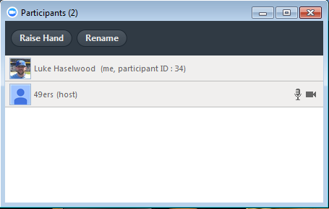
Zoom Overview
Mute/unmute your microphone
Turn on/off camera
View participant list
Raise hand chat - chat with individuals or all in meeting
Record (if host has given permission)

Slide 3
What are health disparities?
Healthy People 2020 defines a health disparity as
“a particular type of health difference that is closely linked with social, economic, and/or environmental disadvantage.”
Race
Ethnicity
Immigrant status
Disability
Sex or gender
Sexual orientation
Geography
Socioeconomic status
Notes:
Health disparities adversely affect groups of people who have systematically experienced greater obstacles to health based on their racial or ethnic group; religion; socioeconomic status; gender; age; mental health; cognitive, sensory, or physical disability; sexual orientation or gender identity; geographic location; or other characteristics historically linked to discrimination or exclusion.

Slide 4
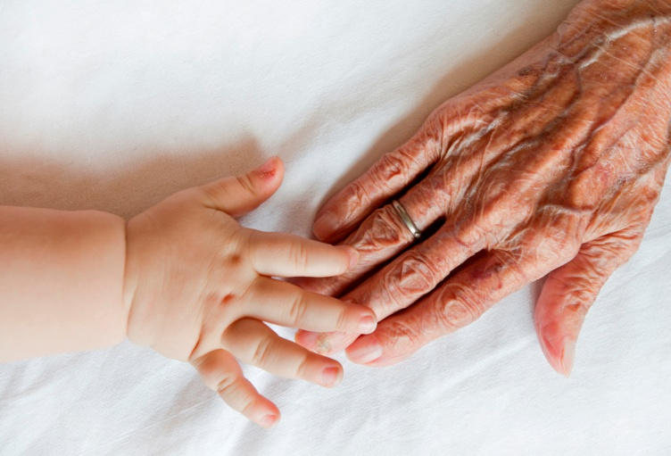
Looking at Health Disparities

Slide 5
One of the most changeable factors
of health inequalities/disparities is the lack of culturally and linguistically appropriate services.
Culturally and linguistically appropriate services
are increasingly recognized as effective
in improving the quality of care and services

Slide 6
“The purpose of the enhanced National CLAS Standards is to provide a blueprint for health and health care organizations to implement culturally and linguistically appropriate services that will advance health equity, improve quality, and help eliminate health care disparities.”

Slide 7
As part of the public health workforce,
we have been tasked with incorporating
cultural and linguistic competency
into the provision of public health services.

Slide 8
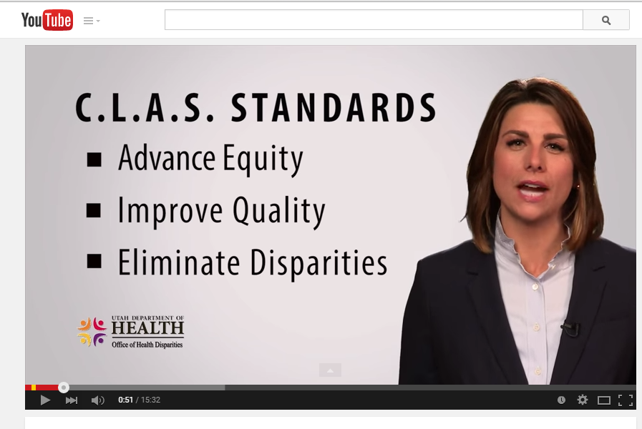

Slide 9
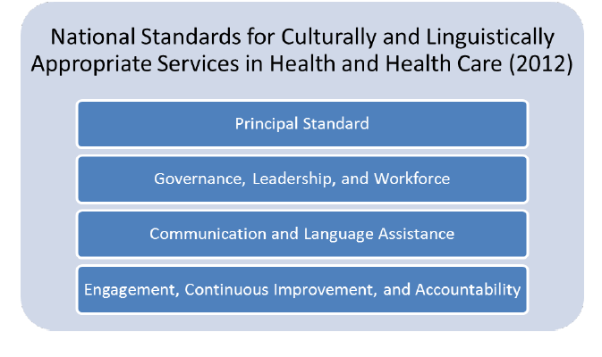

Slide 10
Principal Standard
1. Provide effective, equitable, understandable, and respectful quality care and services that are responsive to diverse cultural health beliefs and practices, preferred languages, health literacy, and other communication needs.

Slide 11
Governance, Leadership and Workforce
2. Advance and sustain organizational governance and leadership that promotes CLAS and health equity through policy, practices, and allocated resources.
3. Recruit, promote, and support a culturally and linguistically diverse governance, leadership, and workforce that are responsive to the population in the service area.
4. Educate and train governance, leadership, and workforce in culturally and linguistically appropriate policies and practices on an ongoing basis.

Slide 12
Communication and Language Assistance
5. Offer language assistance to individuals who have limited English proficiency and/or other communication needs, at no cost to them, to facilitate timely access to all health care and services.
6. Inform all individuals of the availability of language assistance services clearly and in their preferred language, verbally and in writing.
7. Ensure the competence of individuals providing language assistance, recognizing that the use of untrained individuals and/or minors as interpreters should be avoided.
8. Provide easy-to-understand print and multimedia materials and signage in the languages commonly used by the populations in the service area

Slide 13
Engagement, Continuous Improvement and Accountability
9. Establish culturally and linguistically appropriate goals, policies, and management accountability, and infuse them throughout the organization's planning and operations.
10. Conduct ongoing assessments of the organization's CLAS-related activities and integrate CLAS-related measures into measurement and continuous quality improvement activities.
11. Collect and maintain accurate and reliable demographic data to monitor and evaluate the impact of CLAS on health equity and outcomes and to inform service delivery.

Slide 14
Engagement, Continuous Improvement and Accountability, (continued)
12. Conduct regular assessments of community health assets and needs and use the results to plan and implement services that respond to the cultural and linguistic diversity of populations in the service area.
13. Partner with the community to design, implement, and evaluate policies, practices, and services to ensure cultural and linguistic appropriateness.
14. Create conflict and grievance resolution processes that are culturally and linguistically appropriate to identify, prevent, and resolve conflicts or complaints.
15. Communicate the organization's progress in implementing and sustaining CLAS to all stakeholders, constituents, and the general public.

Slide 15
IPFS Project Focus
Access
Diverse cultural health beliefs and perspectives
Preferred Languages
Health Literacy
Use/Reach
Track, monitor and review data through program data collection systems
Outcome
Utilize data to make program adjustments and implementations based on the needs of disparate populations

Slide 16
Next steps/big picture
Start thinking about what the disparate populations may be in your community. How will you find them? Who do you need at your table to assist.
Continued capacity building with a focus on ensuring representation is reflective of the community and brings input from disparate populations. Think beyond race and ethnicity.
Identify and communicate training and TA needs to project staff

Slide 17
Next Steps cont.
In the next several months you will receive additional information and training on:
Incorporating CLAS into strategic planning, implementation and evaluation
Cultural Competence

Slide 18
Resources
Think Cultural Health Website, U.S. Department of Health and Human Services Office of Minority Health
https://www.thinkculturalhealth.hhs.gov
https://www.thinkculturalhealth.hhs.gov/pdfs/EnhancedCLASStandardsBlueprint.pdf
Massachusetts Resources
http://www.mass.gov/eohhs/gov/departments/dph/programs/admin/health-equity/clas/making-clas-happen.html
http://masstapp.edc.org/prevention-planning/cultural-and-linguistic-competence#overlay-context=step-5-evaluation/task-3-implementation-evaluation-plan
Utah Resources
http://health.utah.gov/disparities/training/healthin3D.html
https://www.youtube.com/watch?v=0t-PSbZ6lqQ

Slide 19
Questions

